Slide 1
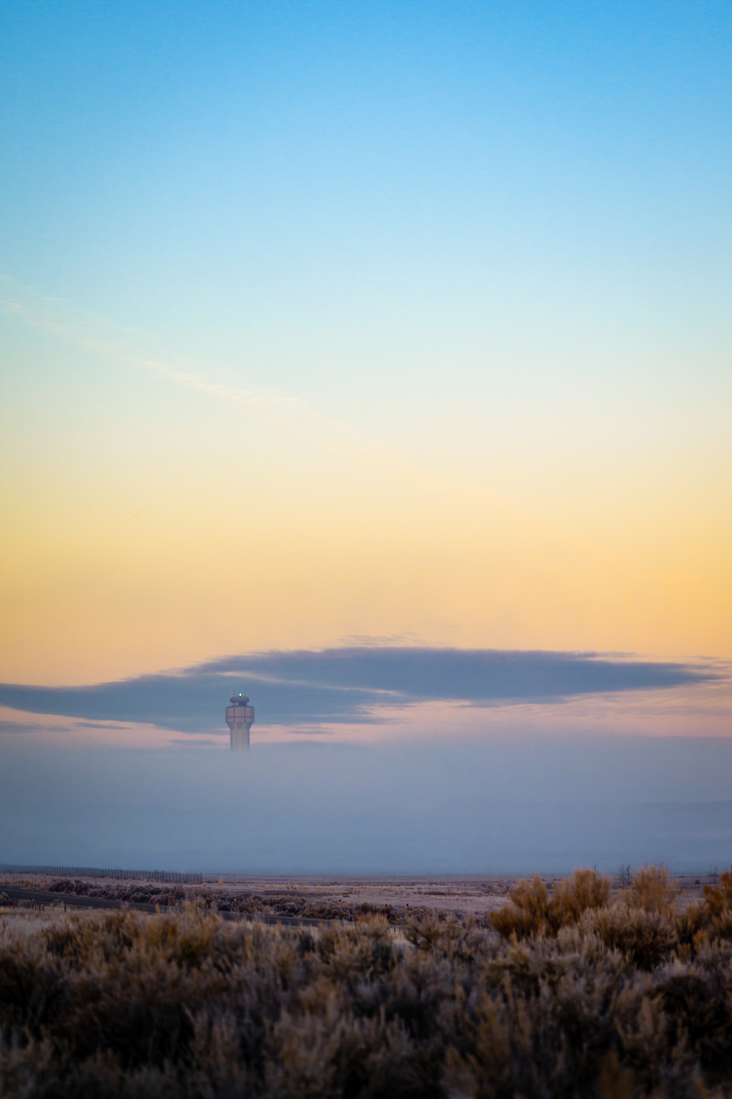

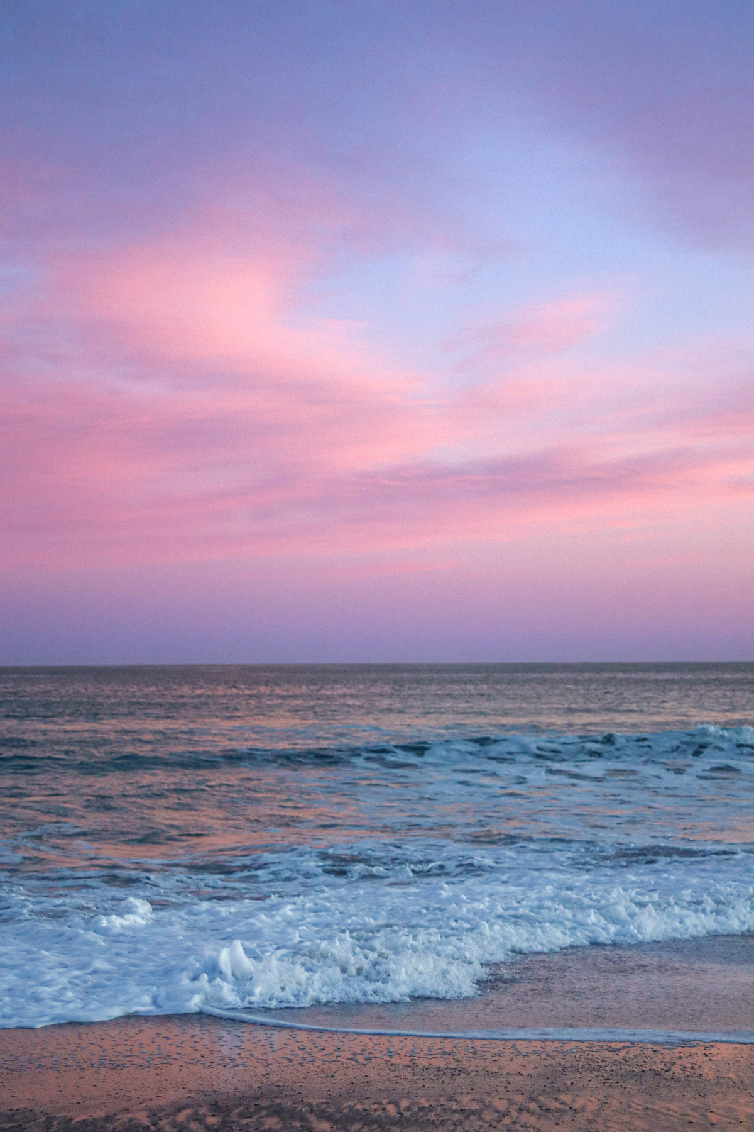
Shawn Garcia
STUDIO SHODWE
Founder and CEO
www.reallygreatsite.com
Creative
Product Mockups
WELCOME

Slide 2
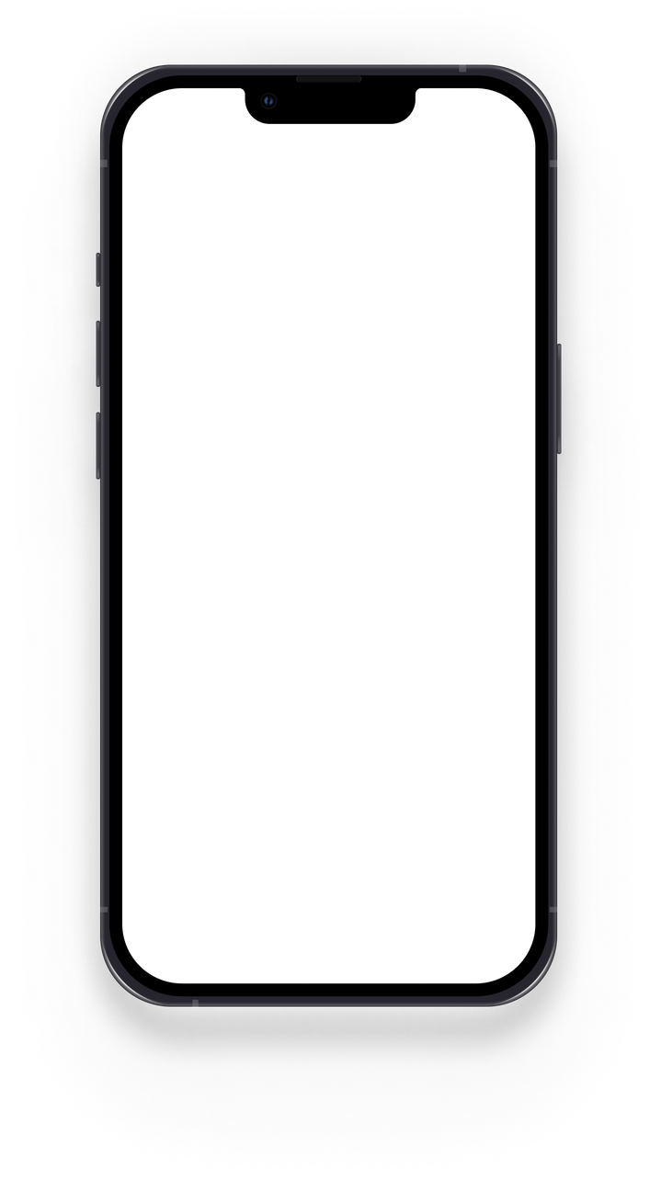
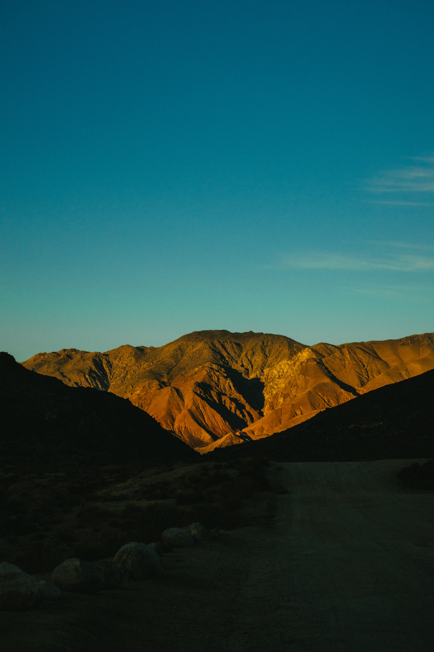
PRODUCT DEMO
Black Midnight
www.reallygreatsite.com
'Notch' Product Mockups

Slide 3
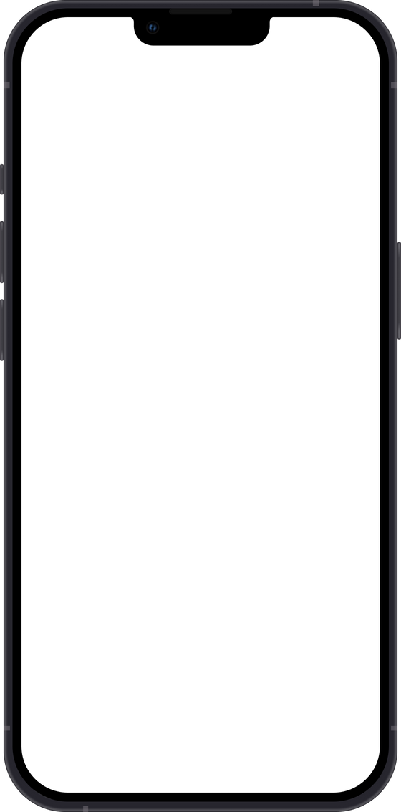
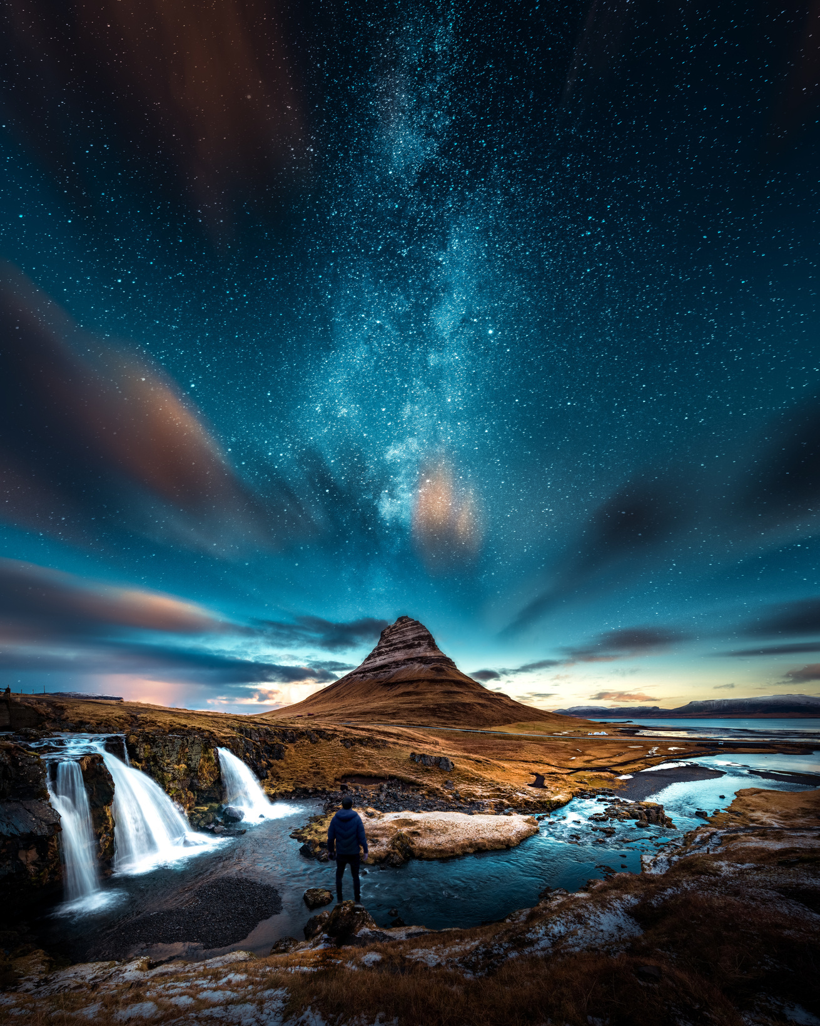
SMARTPHONE PORTRAIT
Black Mockup
Model
Notch
Though black used in contrast–particularly with white or yellow–does create energy, black on its own can be depressing and can dampen the mood.
Shadow
No
Color
Black Midnight
Engagement
Purchases
Keywords
Power
Control
Authority
67%
42%
www.reallygreatsite.com
'Notch' Product Mockups

Slide 4
SMARTPHONE PORTRAIT
Black Mockup
Model
Notch
Though black used in contrast–particularly with white or yellow–does create energy, black on its own can be depressing and can dampen the mood.
Shadow
No
Color
Black Midnight
Engagement
Purchases
Keywords
Power
Control
Authority
67%
42%
www.reallygreatsite.com
'Notch' Product Mockups

Slide 5
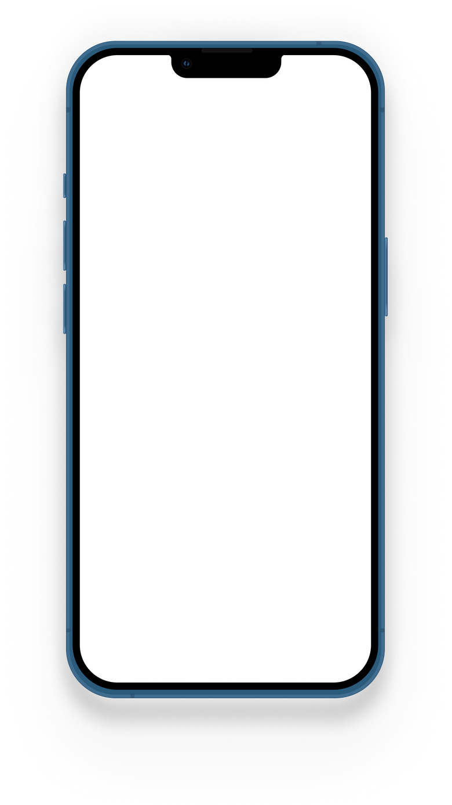

SMARTPHONE PORTRAIT
Blue Mockup
Model
Notch
Blue represents the healing nature of water and the power of stormy seas. It’s what separates bodies of land from one another, and it’s a marker of loyalty and fidelity.
Shadow
Yes
Color
Blue
Engagement
Purchases
Keywords
Trust Responsibility Honesty
82%
43%
www.reallygreatsite.com
'Notch' Product Mockups

Slide 6
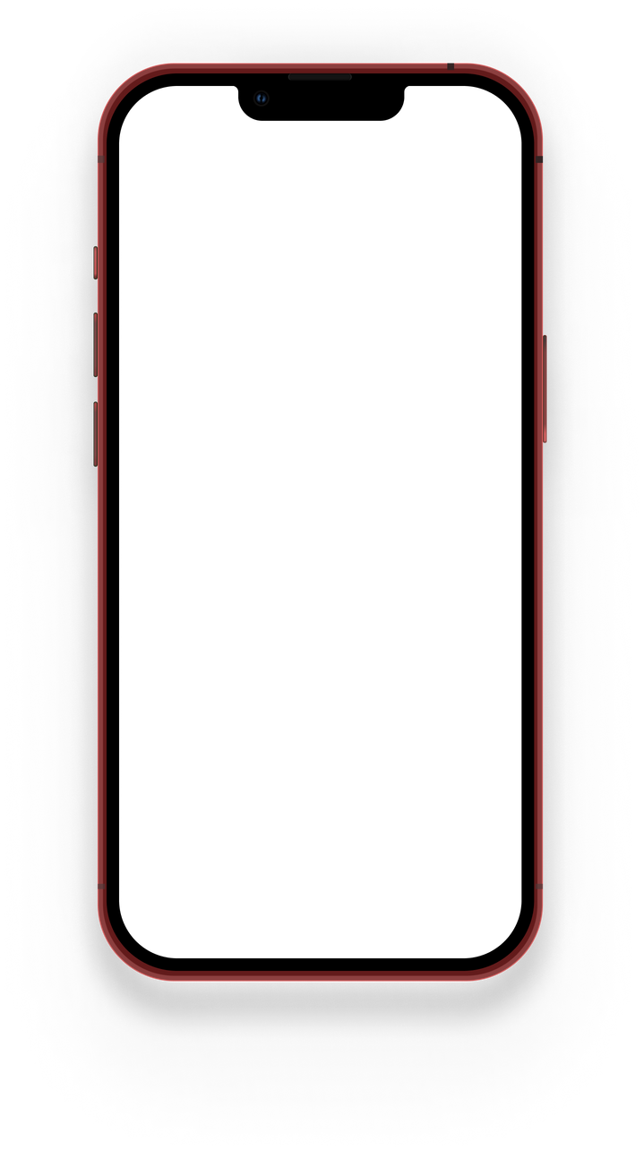
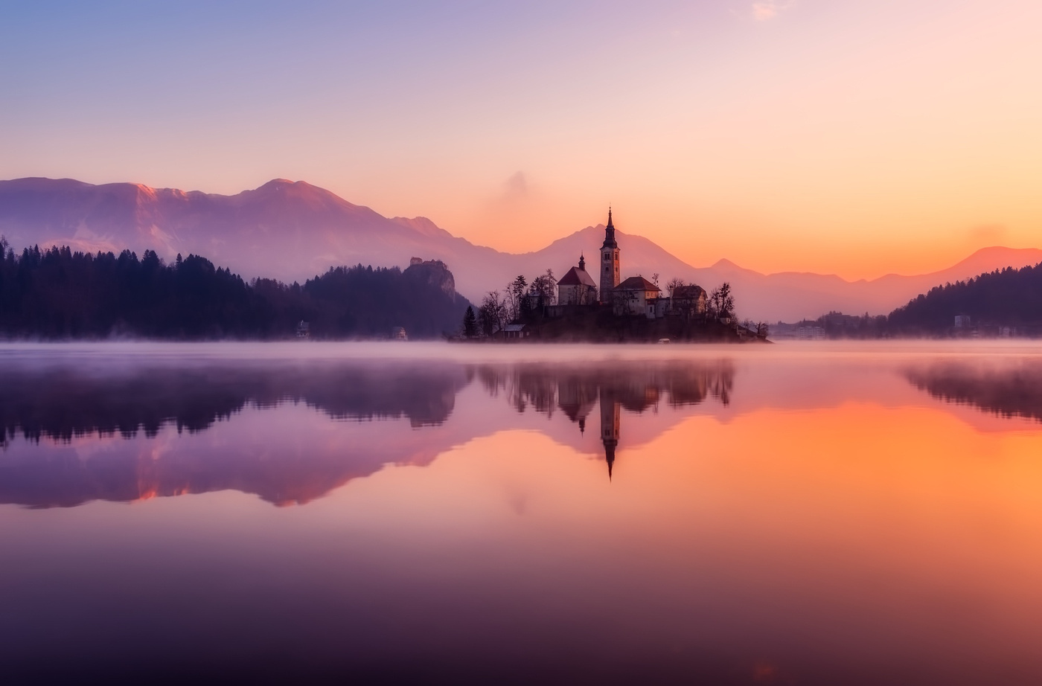
PRODUCT DEMO
Red Mockups
www.reallygreatsite.com
'Notch' Product Mockups

Slide 7
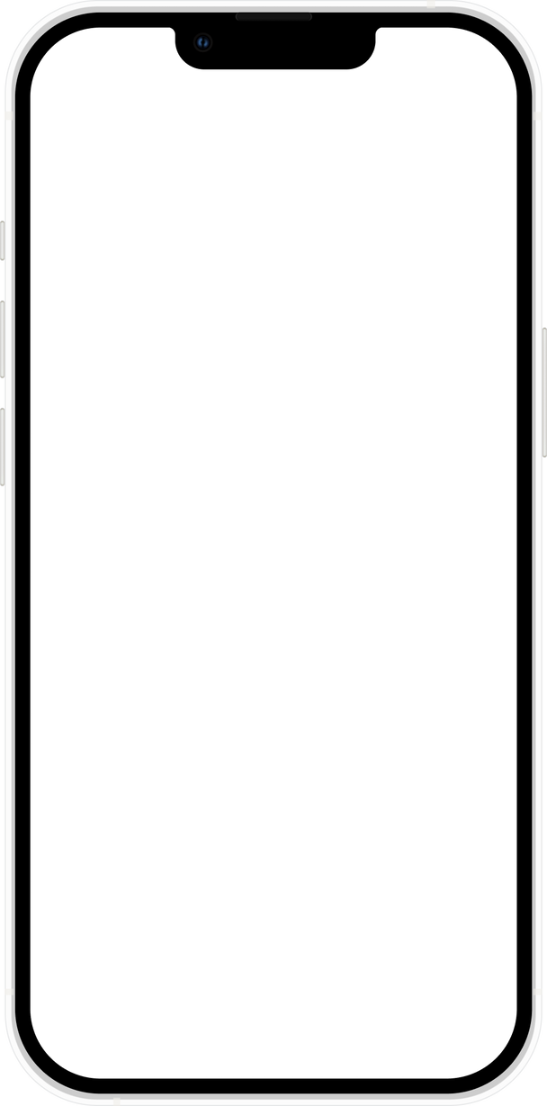

SMARTPHONE PORTRAIT
Starlight Mockup
Model
Notch
In Western cultures, the color white is often associated with weddings, hospitals, and angels and is often used to convey a sense of purity, cleanliness, and peacefulness.
Shadow
No
Color
Starlight
Engagement
Purchases
Keywords
Purity
Innocence
Cleanliness
78%
12%
www.reallygreatsite.com
'Notch' Product Mockups

